Slide 1

Multi-label Classification of Medical Abstracts
Pavan Choudhari | Priya Garg

Slide 2

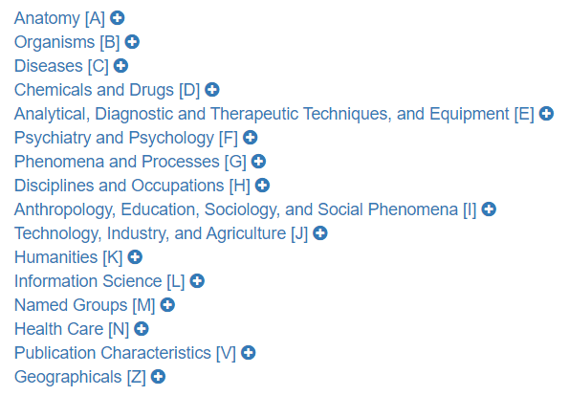
Goal
PubMed is a free search engine that helps researchers and experts search for medical topics by classifying the articles into MeSH headings.
Each year the articles are manually tagged and takes months to assess and tag the millions of research paper.
Our goal is to build a classifier that analyzes the abstract text and automatically classifies the paper into the 15 MeSH root headings.

Slide 3
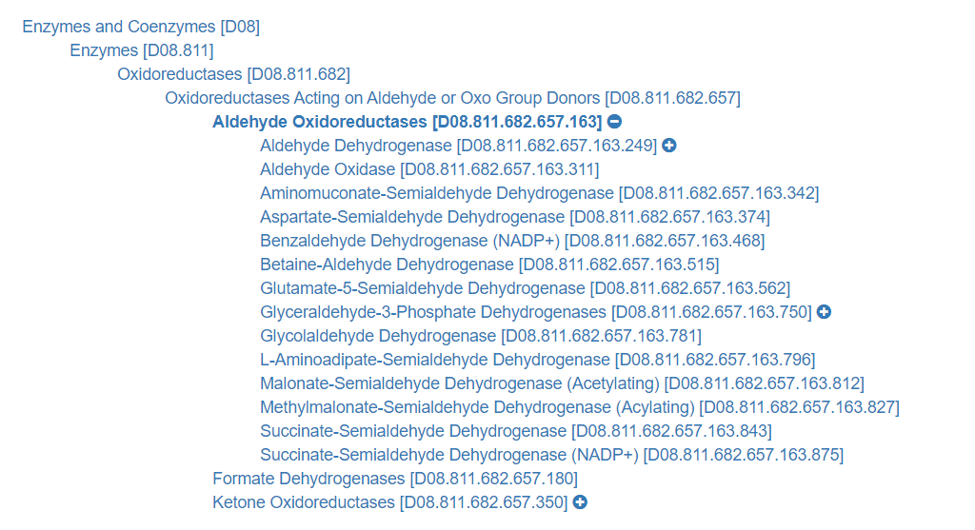
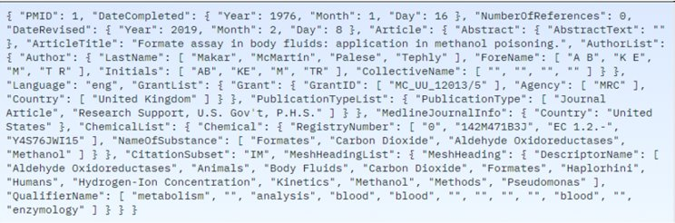
Data Extraction
The label ID for each abstract constitutes the root label category, followed by subcategories.
Our source data has the labels missing.
We extract the labels from the Descriptors.

Slide 4
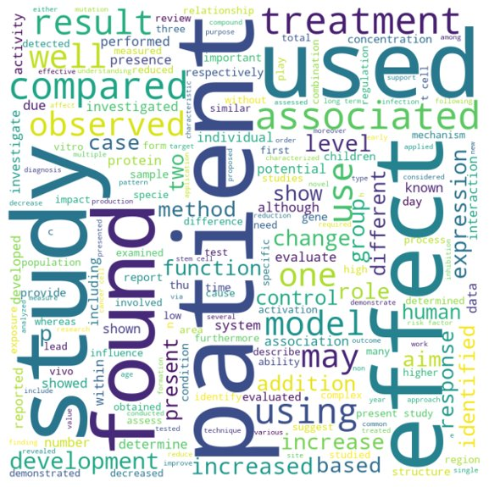
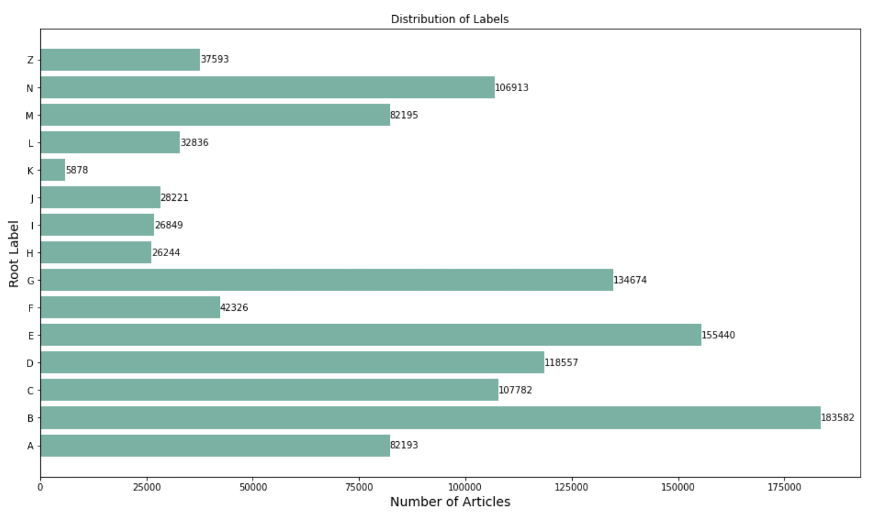
Understanding the Data

Slide 5
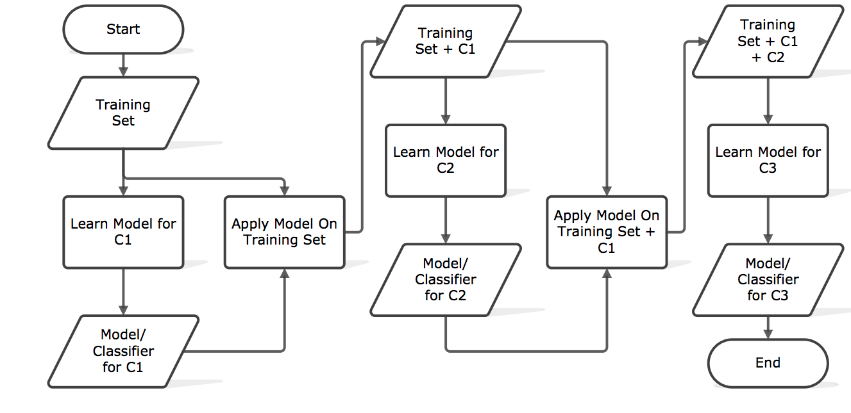
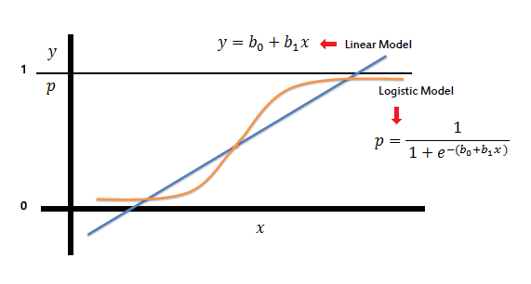
TF-IDF + LR

Slide 6
Word2Vec + Classifier
We use a pretrained BioWordVec model to extract features from the text. We take the mean of feature vectors thus deriving 200-dimensional representation for each abstract.
We train a Logistic Regression, LGBM, Random Forest, and Extra Tree Classifier, and a blend of all these models.

Slide 7
RoBERTa Robustly Optimized BERT pre-training Approach
BERT
Static Masking
Next Sentence Prediction
Training batches of 256 examples
Pretrained on Books Corpus & English Wikipedia – 16 GB
RoBERTa
Dynamic Masking
No NSP, only Masked LM
Training batches of 2000 examples
Additional pretraining on CC News, Open Web Text and Stories corpus – 160 GB
Notes:
As the final part of the Modeling Techniques, we experimented with two different versions of Bert – Roberta and Bio Bert.
Roberta stands for Robustly Optimized BERT pre-training Approach
- It was Introduced in 2019, a year later Bert was introduced. As the name suggest, it is a modified design of bert.
The key differences are -
- BERT uses static masking i.e. masking the same part of the sentence in each Epoch. In contrast, RoBERTa uses dynamic masking, wherein masking is done for different part of the sentences in different Epochs . This makes the model more robust.
- One of the central pieces of Bert, is the Next Sentence Prediction, that is, given two sentences A and B, we ask Bert, does sentence B come after A?
Roberta Simply drops this part of the objective and therefore uses only MLM (Masked language Modeling).
- For RoBerta, the batch size was 2000 examples compared to 256 in Bert, that is, it trained with much larger mini-batches.
- Bert Trained on Books Corpus and English Wikipedia whereas Roberta trained on Books Corpus, CC-News Corpus, OpenWebText & Stories corpus, which is a substantial amount of training data.

Slide 8
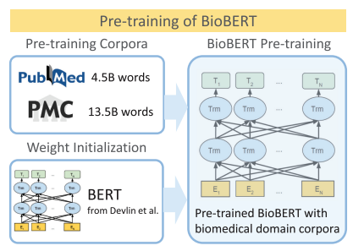
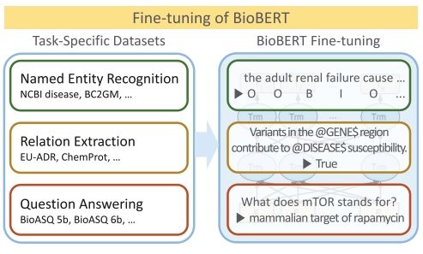
Bio-Bert
Overview of pre-training and Fine Tuning
Notes:
Next, we explore Bio-Bert, Which is a contextualized language representation model, based on BERT
One major problem with domain problems is that there are texts which are only understood by domain experts. Biomedical terms having many proper nouns & terms (e.g., transcriptional, antimicrobial) makes it impossible for a general language model to understand.
- In this approach, Biobert is Initialized with Bert, so, here, rather than taking a random initialization of weights, pre-trained weights from BERT model are taken.
- Next, BioBERT is pre-trained on PubMed Abstracts of 4.5 billion words & PMC Full-text articles containing 13.5 billion words.
- Later, the pre-trained model is used to fine-tune on various biomedical text mining tasks like Named Entity Recognition, question & answer, relation extraction.

Slide 9
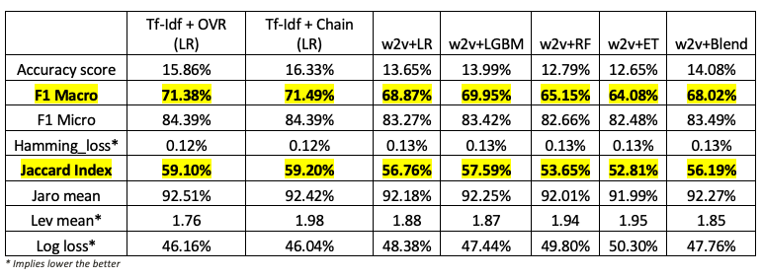
Results - I
Note: Test set contains 5k records
Notes:
Moving on to results, when compared with Binary Classification, the evaluation methods for multi-label classification are quite different. In addition to accuracy , micro F1 and macro-f1, we have leveraged some string matching metrics.
First, Jaccard Index, is the size of intersection of predicted labels and the true labels divided by the size of the union of the predicted & true labels. It ranges from 0 to 1, & 1 is the perfect score. Levenshtein distance/minimum edit distance: is the Minimum number of edits needed to transform one string into the other. Here, the final score is the average of this distance of all records in test data. The Jaro Wrinkler similarity or Jaro score is similar to Levenshtein distance in terms of transformations but it gives more priority to prefix similarity.
Here, all models have been tested on 30% data of the original dataset. It is interesting to note the high Jaro Score, implying that the former labels are being predicted well than the latter ones however, this pattern is seen because the former labels, such as 'B' standing for organisms is present in 92% of data.
Also, it is expected to have low accuracy as we have 15 labels and only the exact match of true and predicted label is counted as an accurate prediction.
Here, our winning model is Logistic Regression with Tf-Idf with F1- macro score of .71

Slide 10
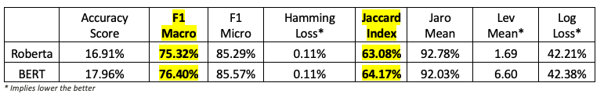
Results - II
Note: Test set contains 190k records
Notes:
In an effort to improve this score, we experimented with transfer learning as discussed before.
We were able to test both Bio-Bert and Roberta on a different test file, which is not a subset of the original file. This certainly ensures that our models are robust.
As expected, both Bio-bert and Roberta performs better than the previous classifiers. And Bio-Bert performs slightly better than Roberta in terms of F1-score.
However, it is interesting to note that the other metrics such as Hamming loss, logloss, accuracy do not improve much from the previously stated best model.

Slide 11

Limitations/Future Work
Compute Capacity: GPU workload increases cost
Lack of Evaluation metrics for multi-label classification
Pre-trained bio w2v embeddings for transformer models
Text Generation with Author Attribution Task – for next research :)
Notes:
Finally, Moving on to limitations
In our project we were limited to only a few hours of training time.
Secondly, The most common used metric for multi-label classification is F1-score. As we saw before, string matching metrics do not give reliable comparisons.
- In future, we can also explore the idea of using pretrained word2vec embeddings as input to the transformer models, basically combining our last 2 approaches.
- As a long shot, we can extract the author's learning style with author attribution task and using text generating techniques, we can help the author to write their next research!

Slide 12
Thank you !

